Slide 1

FakeNews Classification
Instructor: Dr. Haifa al-kasem
Khloud Alnufaie | 440020617
Raghad Albosais | 440020209
Weaam Alghaith | 440023306
Section : 371

Slide 2

Introduction
Dataset
TABLE
OF CONTENT
Bert model architecture
Proposed model
Step of implementation
Result
Challenges
Tools and technologies
Conclusion

Slide 3

introduction
Problem overview :
The news can be presented in different formats in social media, such as the articles.
Fake news “is fabricated information that mimics news media content in form but…lack(s) the news media’s editorial norms and processes for ensuring the accuracy and credibility of information”.
One example of sophisticated fake news is “deepfakes”. Deepfakes are fictional videos or images or text with either well-known or made-up people doing, or saying, things that are not real. This is created using artificial intelligence and machine learning.
3

Slide 4

Problem statements :
Task (T) | Classify an article to a real or a fake
Experience (E) | A collection of real and fake articles
Performance (P) | Classification evaluation metrics, which is accuracy, precision and recall. All of them are calculated based on the confusion matrix part (TP, TN, FP, FN)
4

Slide 5

Problem statements :
Motivation and project goal :
Fake news can have devastating effects on democracy if people can no longer distinguish between what information is real and what is fake.
In order to detect this fake news and improve consumer trust in the constant flow of online news.
In this project, we aim to build an accurate DL-model to detect and classify articles as fake and news.
5

Slide 6
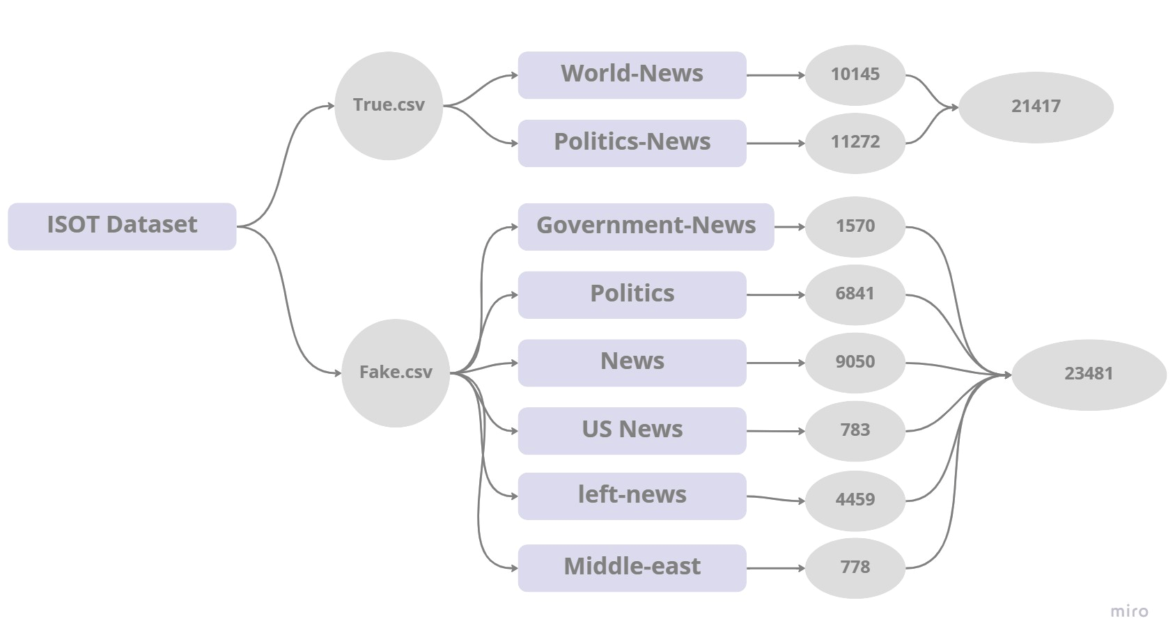
Dataset
ISOT Fake News Dataset includes both fake and real news articles. This dataset is collected and provided in this IOST research lab. Articles were retrieved by crawling Reuters.com (News website) for truthful articles.
6

Slide 7
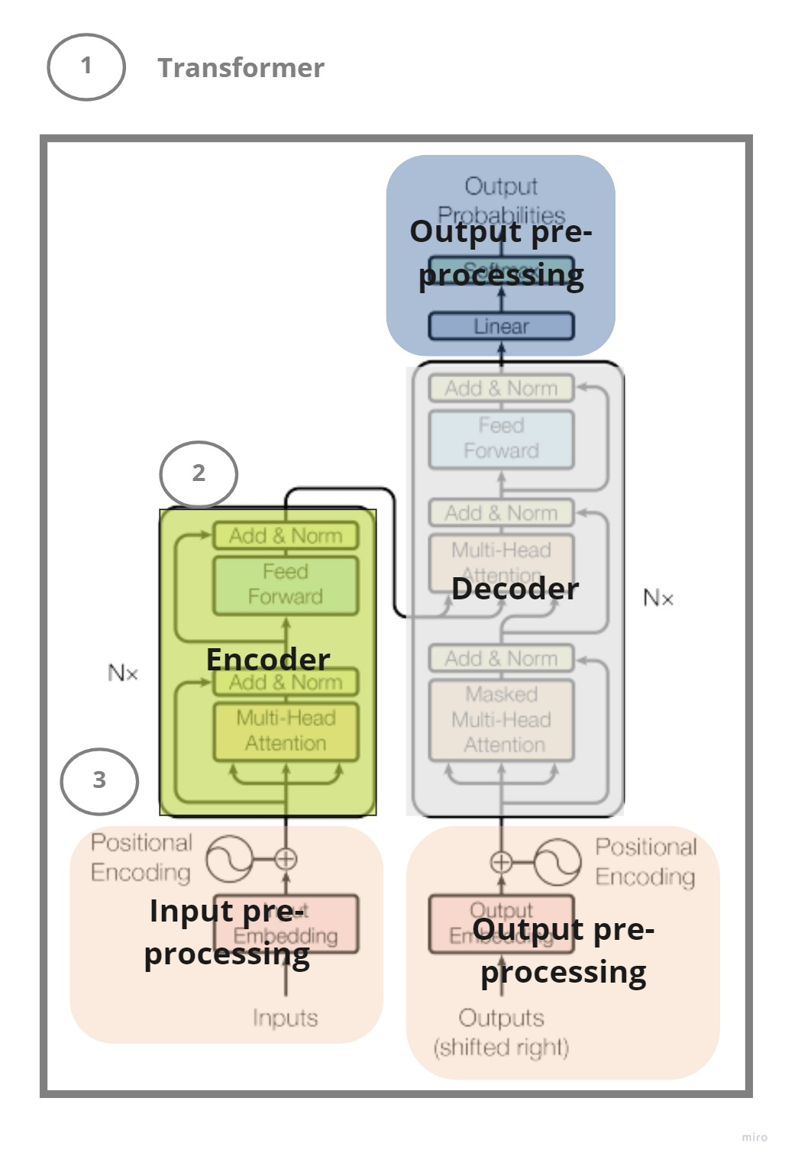
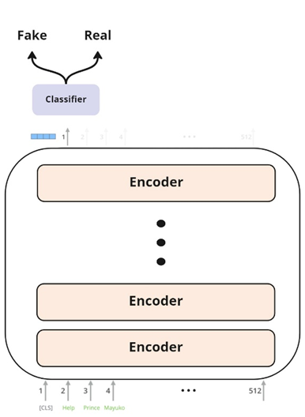
Bert model architecture
….
7

Slide 8
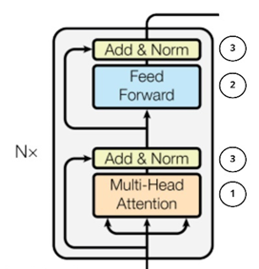
Bert model architecture
A multi-head self-attention mechanism on the input vectors. The model can capture more relationships between words with multi-head attention than single-head attention.
fully connected feed-forward network is a position-wise that applied to each position separately and identically. Two linear transformations are applied with a ReLU activation in between. Linear transformations are the same across different layers but use different parameters.
"Adding and Normalizing" - the "add" refers to the residual connections that add the input of each layer to the output, and the "Norm" refers to layer normalization.
8

Slide 9
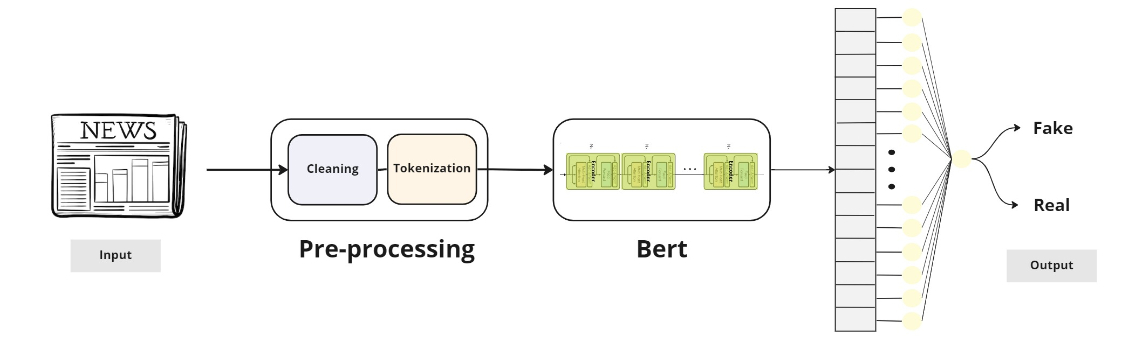
Proposed model
9

Slide 10



Preparing the data
Step of implementation
Model development & evaluation
Let’s describe
Model prediction / inference
10

Slide 11










Preparing the data
Loading the data
Exploring the data
preprocess data
merge data
splitting the data
Tokenize the data
11

Slide 12
Model development & evaluation
Input
Cleaning
Tokenize
BERT
model
Dense
layer
Output
Training workflow
Input
Cleaning
Tokenize
BERT
model
Dense
layer
Output
Evaluation metrics
Testing workflow
12

Slide 13
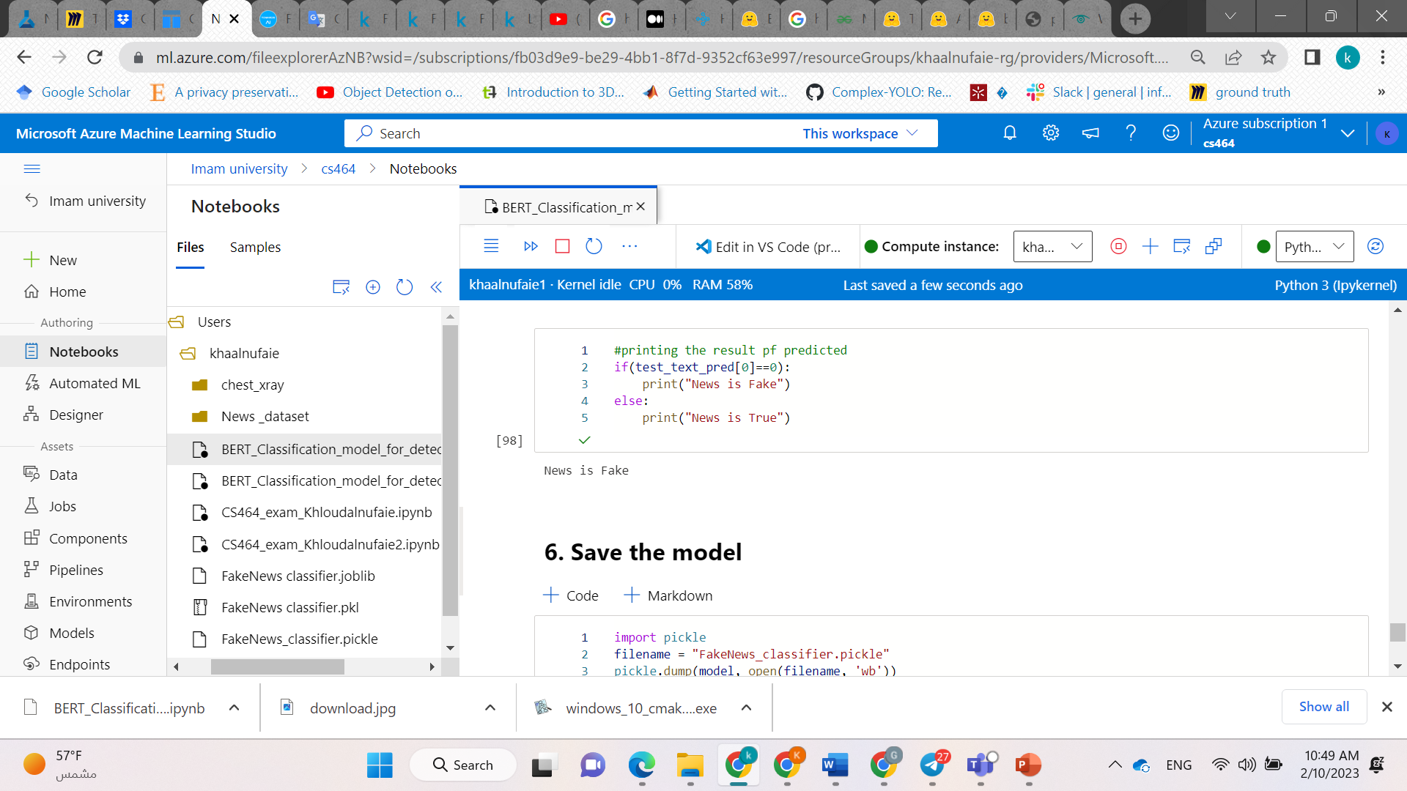
Model prediction / inference
Cop Shares Racist Meme About Michelle Obama; Now That Cop Is Having A VERY Bad Day (IMAGES)After the election of Donald Trump many folks seem to see it as a permission slip to be as racist and vile as possible. However, here s the thing, you re still going to get called out as racist and vile. And one Alabama police officer just found this out the hard way.According to the Washington Post: Talladega Police Officer Joel Husk was terminated Wednesday for violating the department s social media and code of conduct policies, City Manager Patrick Bryant said. What did he do? So glad you asked: Husk had posted several memes on his Facebook page, including one showing Obama and Melania Trump. Fluent in Slovenian, English, French, Serbian, and German, it said over Trump s photo. Over Obama s, it read: Fluent in Ghetto. Not only that, he posted several extraordinarily racist memes:via Washington Postvia Washington PostAccording to the City Manager, the statements were deemed to be biased or racially insensitive or derogatory and because of that, they have to take action to correct it. If you re going to be a police officer and serve all the public, you can t assume black people standing up for their rights are equivalent to the KKK. That s about the most horrific equivalence imaginable.Also, according to WaPo: Husk, 37, who had been with the department for about two and a half years, had also shared a meme showing President Obama with the words: Was Dallas a terrorist attack? Yes! Carried out by Obama s own homegrown terrorist group! Which is a blatant lie and anyone who were to feel that way belongs nowhere near law enforcement. The city took the proper action letting this racist cop go, and hopefully it will be an example to police departments all over the country that this sort of behavior simply cannot be tolerated.Trump s election must not be allowed to serve as a permission slip to bigots everywhere that it s fine to be as awful as possible, because here in the land of the free and the home of the brave, everyone is protected. Everyone, regardless of color, class, gender, sexual orientation, or creed.Featured Photo by Chip Somodevilla/Getty Images
Tokenize
Classifier
13

Slide 14
Result
1
Experiment without cleaning
we conducted two experiments in order to see the effectiveness of the model when and when not we remove the punctuation from the fake sets.
2
Experiment with cleaning
14

Slide 15
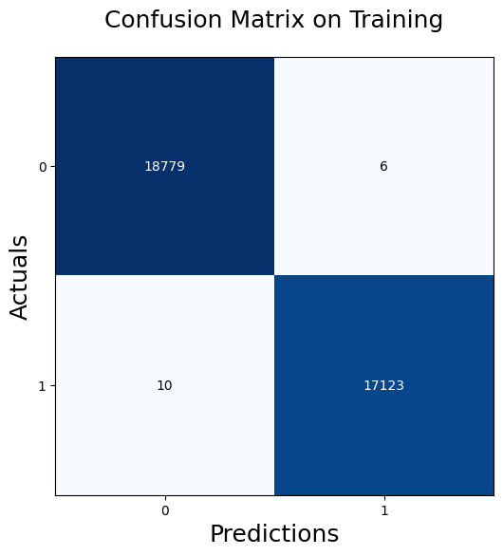
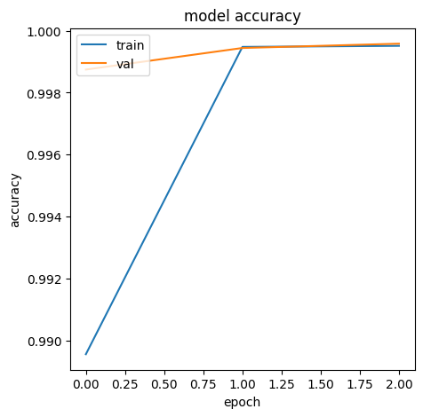

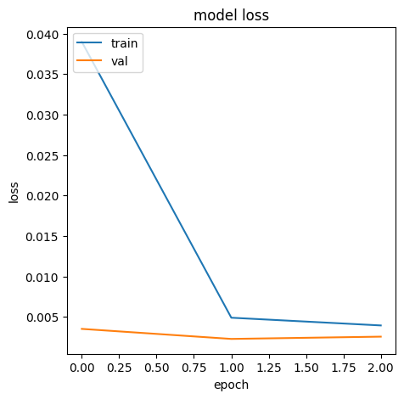
Experiment without cleaning
Confusion Metrix
Accuracy & loss curve
15

Slide 16

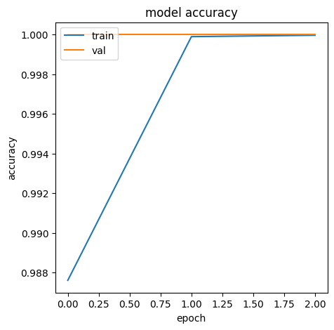

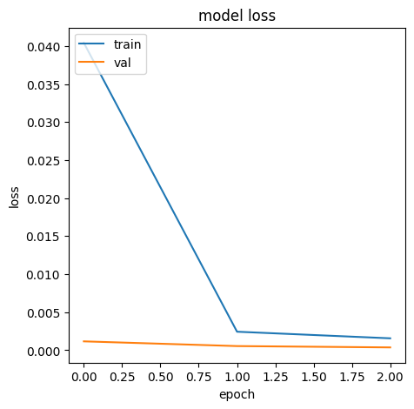
Experiment with cleaning
Confusion Metrix
Accuracy & loss curve
16

Slide 17
EX # | Input | Preprocessing | Test Acc | Test loss | Test Precision | Test Recall | Test F1
EX1 | Title + content | Tokenization | 99.96% | 0.0 | 1.0 | 0.99 | 0.99
EX2 | Title + content | Tokenization + Remove punctuation from fake set only. | 100% | 0.0 | 1.0 | 1.0 | 1.0
Result
17

Slide 18


Problem statements :
Challenges :
Understanding the concepts related to NLP.
Choosing the best pre-trained model among many NLP models for given dataset.
Long run-time.
Choosing parameters values for tokenizer was challenging since its first-time deal with tokenization process.
Errors in save model step due to TypeError in package joblib.
Find the most influence performance measurement for our task between TP, TN, FP, FN where are the parameter used in the evaluation of specificity, sensitivity, and accuracy.
18

Slide 19





IDA
Implementation tool
programing language
Tools and technologies
libraries
Pandas Csv Matplotlib
Seaborn Wordcloud Numpy
String Joblib Tensorflow
Keras Transformers
Documentation tool
Design tool
19

Slide 20
Conclusion
The model takes the title and content of a news article, then classify this article as fake or real. we achieve high performance, in term of accuracy, our model performs 100% on testing data with punctuation removal processing and 99.96% on testing data without punctuation removal processing. As a future work, we will implement different types of pre-trained model on same dataset and compare the results between them.
20

Slide 21
THANK YOU

